Slide 1

서강대학교 ICT법경제연구소 세미나 Machine Learning and Market Competition: Some Preliminary Thoughts
Haksoo Ko
Seoul National University
August 31, 2017

Slide 2

New Era: Advent of Machine Learning!
Competition Issues related to Machine Learning

Slide 3
New Era:
Advent of Machine Learning!

Slide 4
Machine Learning
Machine learning, in general
X=features, classifiers, characteristics, covariates
Y=label, category, outcome
Deep learning
(X, Y): supervised learning
X alone: unsupervised learning, clustering problem
Reinforcement learning
Not maximizing predictive accuracy, but maximizing value
Periodically updating “policy” and “value” in order to maximize the probability of winning
Generating additional data through self-play

Slide 5
Machine Learning: Pre-requisites
Greg Corrado, “Machine Intelligence at Google” (2016)

Slide 6
Data-driven economy and users’ personal information
Some characteristics of data-driven economy
Massive and continuous collection, analysis, and utilization of (personal) data
Collection is important
However, collection itself is not the goal
Data analytics and its business utilization are what matters.
Competition often happens at a platform level
Network externalities; multi-sided market
Platform competition often entails competition for user data, at the same time
Platform-level competition may, or may not, foster competition
Impact of data on competition?

Slide 7
Role of data in platform competition?
Significance of data: analytics
→ (1) pattern recognition, (2) marketing, (3) demand estimation…
Platform business
Often serviced for free
→ In return, collection of user data
Ability to collect data and conduct analytics became an important dimension of competition
In particular, in a multi-sided market (e.g., ‘match-making’ type), having individualized information on each user is crucial
(1) important for ‘good’ match with another user who belongs to another side of the market;
(2) important for purposes of targeted advertisement

Slide 8

D. Evans, “The Online Advertising Industry:
Economics, Evolution, and Privacy” JEP (2009)

Slide 9


Slide 10
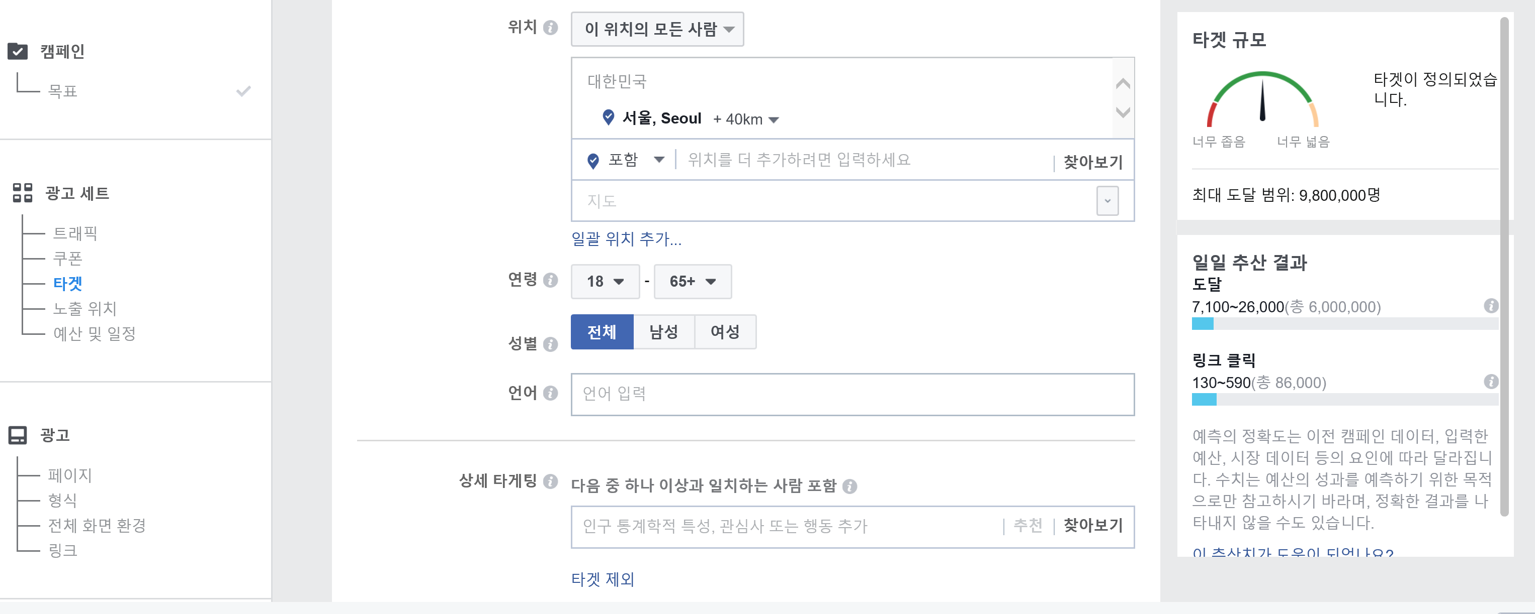

Slide 11
Competition Issues related to Machine Learning

Slide 12
Competition Issues related to Machine Learning
Competition when ML is involved
Market competition may involve (1) platform competition, and may show (2) network externalities
→ From a competitor’s perspective, it could be crucial to preempt the market, to provide de facto standards, and to secure many users at an early stage
ML product may or may not form a separate market
ML may only play a role of improving existing products
Even when there’s no separate market for an ML product, there may well be fierce competition underneath among existing competitors
Thus, many technology companies provide API (application programming interface) for free
To try to secure a large ‘installed user base’, and to induce ‘tipping’
Through this, at the same time, competition takes place to collect users’ data

Slide 13
Competition Issues related to Machine Learning
Competition when ML is involved
Competition sometimes involves widespread use of robots (bots) in order to monitor competitors’ behavior, in particular pricing behavior
Automated price adjustment mechanism, reflecting the result of monitoring ← very low “menu cost”
Constant monitoring of pricing behavior of competitors
This may paradoxically lead to price rigidity
Although competitors may be exposed to tremendous competitive pressure, “conscious parallelism” may be a market outcome

Slide 14
Competition Issues related to Machine Learning
Case of ‘price matching/guaranteeing lowest price’
Conceptually a form of MFN (most-favored-nation clause)
Would the resulting prices resemble the prices that would be formed under perfect competition?
Or, on the contrary, to induce tacit collusion or something analogous to collusion?
Possibility of overall upward shift of prices, and of price rigidity
Plausibility of MFN (and of lessening of competition)
Widespread use of robots and the possibility of monitoring competitors’ prices easily
“lowest price guarantee” could lead to overall price rigidity
This could even function as de facto “entry barrier”

Slide 15
Competition Issues related to Machine Learning
Algorithmic tacit collusion might be facilitated, if
Concentrated markets with homogeneous products
In such markets monitoring competitors’ behavior would be less burdensome
Credible deterrence or punishment possible for deviation
Speedy and effective retaliation would be a key
Markets with diffused consumers
Consumers are unable to exert de facto bargaining power as a group
Markets where algorithms with similar functionality and where market data are available among competitors
Industry-wide use of a single algorithm
Industry-wide sharing of relevant data
See Ezrachi and Stucke, “Two Artificial Neural Networks Meet in an Online Hub and Change the Future (of Competition, Market Dynamics and Socity)” (2017)

Slide 16
Competition Issues related to Machine Learning
ML, Big Data analytics and price discrimination
Businesses would try to engage in extensive monitoring of consumers’ behavior, conduct analysis regarding individuals’ preference structure, and, try to offer tailored and targeted services
At the same time, prices could also be tailored, targeted prices, which reflect consumers’ individual level “willingness to pay”
In the extreme, this could be a perfect (first degree) price discrimination
Economic impact of price discrimination
Dead-weight loss could be reduced → beneficial to social welfare
Consumer surplus could be reduced, while producer surplus could be enlarged → detrimental impact on wealth distribution possible

Slide 17
Competition Issues related to Machine Learning
Enforcement challenges
Liability
Imputing liability could be difficult for a company’s unilateral competitive behavior, using algorithms and available data
Detection
Even if above-competition level prices are prevalent, it could be difficult to detect
It could be difficult to assess competition-level prices
Also, auditing or verifying algorithms may not be practicable due to (1) concerns on gaming/abusing and (2) lack of explainability

Slide 18
Concluding observations
ML may, or may not, facilitate collusive behavior and/or lead to price rigidity
Conjectures explained above are mostly theoretical or anecdotal
More detailed analyses in individual markets are needed
Enforcement is a separate issue
Further discussions are warranted as to whether liability can be imputed
Even when there might be anti-competitive behavior, detection and verification could be troublesome
→ New challenges for regulators and researchers!

